Slide 1
COS 212 Treaps

Slide 2
Heaps VS BSTs
Difference between a heap and a BST:
Heap
Binary Search Tree
el
el
≤ el
≤ el
< el
≥ el
Perfectly balanced at all times Immediate access to maximal (or minimal) element Easy to code (array-ased) Does not provide efficient search | Efficient binary search O(lg n) when balanced Structure depends on the order in which items are inserted Complicated algorithms necessary to keep the tree balanced

Slide 3
Treaps (Trees + Heaps)
“Best-of-both”: an amalgamation of heaps and BSTs
A binary search tree where every node has both a value and a priority
Values are stored in the BST fashion
Priorities determine which nodes are closer to the root
Advantage over heaps: binary search is possible!
Advantage over BSTs: priorities can facilitate efficiency (automatic balancing)
K
D R
M
8
2 6
5
K/8
D/2 R/6
M/5
binary search tree
heap
treap

Slide 4
Treaps
Another name for treaps: randomized binary search trees
Why: because priorities are often randomly generated
?!?!
It turns out that randomly generated priorities yield a balanced tree structure on average
I.e., with randomly generated priorities, there is a good chance (a high probability) that the tree will be in a balanced shape
What this essentially means:
We use heap algorithms to imitate tree balancing
Balancing is randomized! (It is easier to implement this way)
K
D R
M
8
2 6
5
K/8
D/2 R/6
M/5
binary search tree
heap
treap

Slide 5
Treaps
Important to remember:
treaps are not real heaps: only property (1) is enforced
i.e., highest priority nodes must be at the top
the tree does not have to be perfectly balanced
We are randomizing anyway – it is OK to approximate
K
D R
M
8
2 6
5
K/8
D/2 R/6
M/5
binary search tree
heap
treap

Slide 6
Treaps: inserting a node
Why do we rotate instead of swapping?
Create a node, randomly generate priority
Inserting into BST:
Perform binary search
Find the empty leaf location where the new node belongs
Insert the node at the found location
Maintaining heap property:
Compare the priority of the new node with the priority of its parent
If the new node has higher priority, rotate the new node about its parent
If new node is not root after the rotation, go to (i)
K
D R
M
8
2 6
5
K/8
D/2 R/6
M/5
binary search tree
heap
treap

Slide 7
Treaps: inserting a node
S/9
T/7
K/8
D/2 T/7
R/6
M/5
K/8
D/2 T/7
R/6
M/5
K/8
D/2 R/6
M/5
T/7
S/9
K/8
D/2 T/7
S/9
R/6
M/5
K/8
D/2 S/9
R/6 T/7
M/5
S/9
K/8 T/7
D/2 R/6
M/5

Slide 8
Treaps: inserting a node
O/10
S/9
K/8 T/7
D/2 R/6
M/5
S/9
K/8 T/7
D/2 R/6
O/10
S/9
K/8 T/7
D/2 R/6
M/5
O/10
M/5
S/9
K/8 T/7
D/2 O/10
M/5 R/6
O/10
K/8 S/9
D/2 M/5 R/6 T/7
S/9
O/10 T/7
K/8 R/6
D/2 M/5
Perfect balance!

Slide 9
Treaps: removing a node
Treaps are BSTs, therefore we may remove any node, not necessarily the root
Using binary search, find the node you wish to remove
Rotate the higher priority child about the node
Repeat (2) until the node you wish to remove becomes:
A node with one child
A leaf node
In both case (a) and case (b), node removal becomes trivial

Slide 10
Treaps: removing a node
Delete O
S/9
O/10 T/7
K/8 R/6
D/2 M/5
S/9
K/8 T/7
D/2 O/10
M/5 R/6
O/10
K/8 S/9
D/2 M/5 R/6 T/7
S/9
K/8 T/7
D/2 R/6
O/10
S/9
K/8 T/7
D/2 R/6
M/5
S/9
K/8 T/7
D/2 M/5
Delete R
M/5

Slide 11
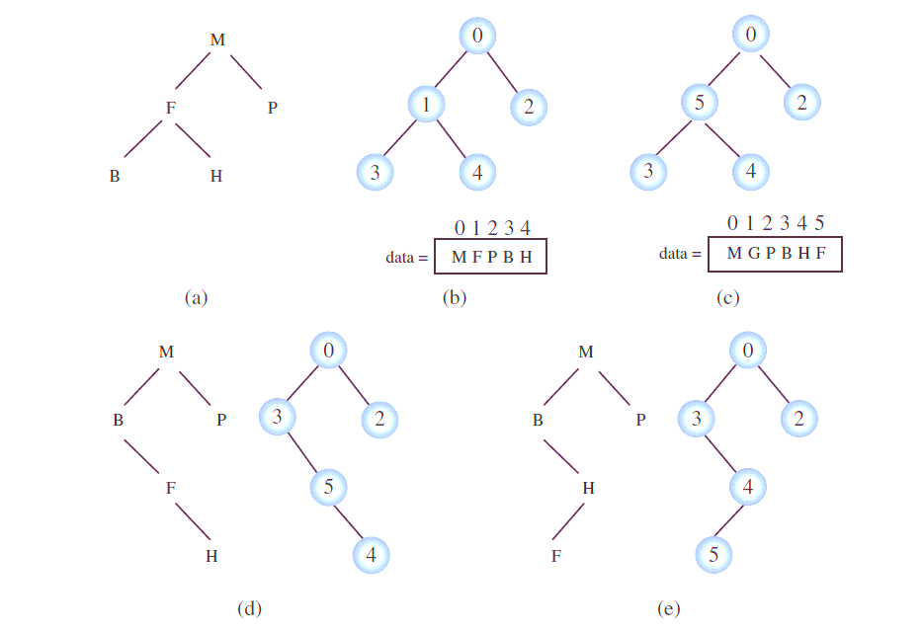
Treaps: implementation
How are we going to implement treaps?
Can we use array implementation (like a heap)?
Can we use BST implementation (linked list-like)?
Every node can store an extra variable: priority
Alternatively:
Store data in an array
Array indices == priorities
Maintain a BST structure that only stores indices in the min-heap fashion (lowest index on top)
Min-Heap

Slide 12
Treaps: implementation
Inserting item into the treap:
If n is the first unoccupied location in the array:
Randomly generate index i <= n
If i == n (lowest priority), the item is added to the end of the array, and the index is inserted into the BST according to BST rules
Else, we are inserting into an occupied position!
In the array: Move current resident of i to position n in the array
In the BST: priority of i changed to n! Perform a series of rotations to restore min-heap property
Now that i is free:
In the array: place new item in position i
In the BST: insert item i, perform a series of rotations to restore min-heap property
Insert G with priority 1
Next page

Slide 13
Treaps: insert
Insert G with priority 1

Slide 14
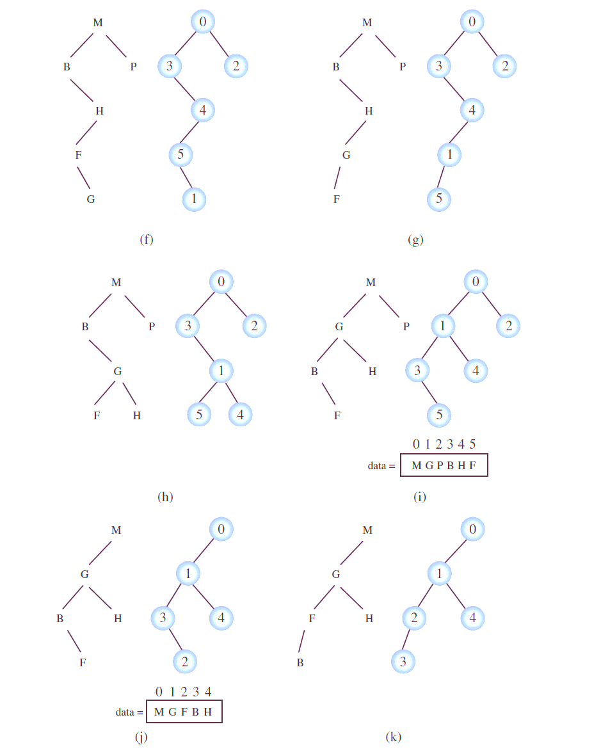
Treaps: insert
Insert G with priority 1

Slide 15
Treaps: implementation
Deleting item from the treap:
Find the item i in the BST
In the BST: Rotate i downwards till it becomes a leaf node, then delete
In the array: Replace item i with item n
In the BST: Item n is now of priority i: perform a series of rotations to restore heap property
Delete P

